Slide 1

Deterministic Finite Automata
CSCI 265 Lecture 2
By Ariel Avshalom

Slide 2


Review
A Deterministic Finite Automata (DFA) is defined by the following 5-tuple:
A finite set of states called ($Q$)
An alphabet (Σ)
A transition function ($δ:Q x Σ →Q$)
A start state ($q_{0} ∈ Q$)
A set of accepting states ($F \text{⊆} Q$)
The above is a formal definition of a DFA. It is possible to also define a DFA with a state diagram
A language is called a regular language if some finite automaton recognizes it

Slide 3
Σ*
We know from beforehand that Σ is the set of symbols our machine can accept
Σ* is the set of all words that can be formed from symbols in Σ
Is Σ* infinite?
When a machine M recognizes a word w in Σ*, we say that w is an element of a language A such that
A = {w | M accepts w}
A is a subset of Σ*
Generally I will refer to languages as L from now on
A machine is as complicated as the language it understands
Example: the language a politician employs in juxtaposition to the language a toddler uses

Slide 4
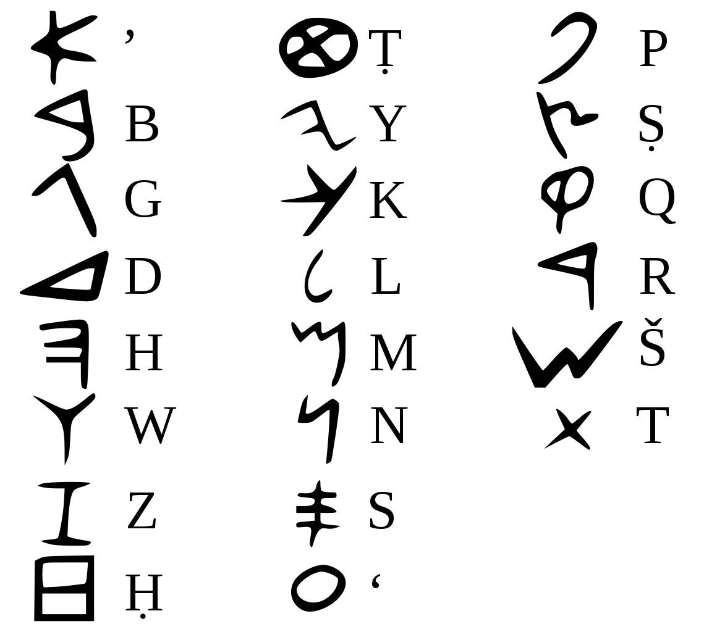
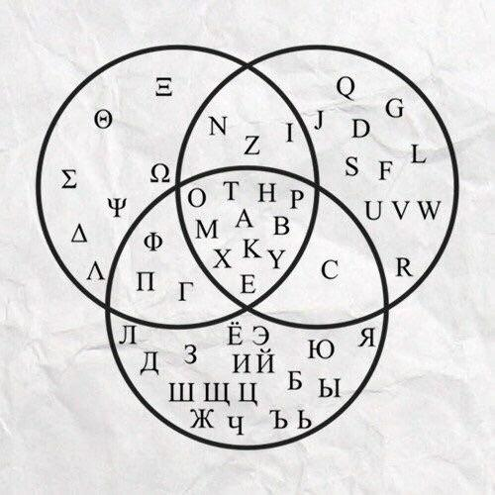
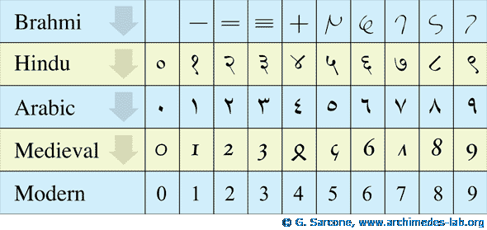
Examples of Σ
Latin letters
Hindu-Arabic numerals
Hebrew, Russian, Bulgarian, Ukrainian, Greek Etc.
Recall that previously, letters were pictorial representations of real-world objects
The reason why we can create words is because we don’t do that anymore
That forms the basis of computation theory

Slide 5


Regular languages in relation
The Powerset of Σ* (𝒫(Σ*))
**Note: This is not to scale
Regular Languages
Finite Automatons
Regular Languages and
Finite Automata are related

Slide 6
Examples of DFAs

Slide 7
Better vending machine
Q = {$0.00, $0.25, $0.50, $0.75, $1.00, $1.25, $1.50, $1.75, $2.00} are the states
Σ = {$0.25, $1.00, select} is the alphabet
δ, the transition function, is described by the state diagram.
q0 = $0.00 is the start state
F = ∅ is the set of accept states

Slide 8

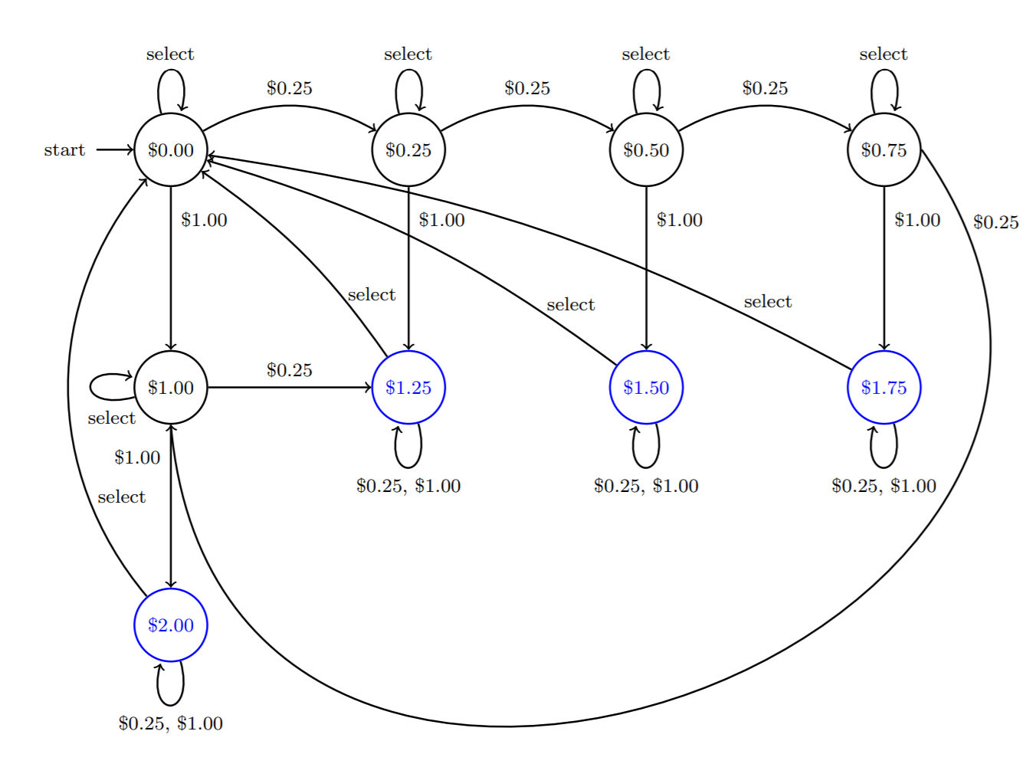
State diagram

Slide 9


Adam, Eve, fruit and a golem
Based on the famous man, wolf, goat and cabbage puzzle
This technically isn’t a DFA (it is a finite automaton), but it will help us think about how to approach these problems
The puzzle works as follows:
A golem wants to move Adam (A), Eve (E) and a particular piece of fruit (F) from one world to another (using some magical golem portal or something)
While the golem is with A, E and F, nothing will happen but:
If A is with E, A will run away with E for reasons
If E is with F, E will eat F
Can we construct an automaton that can give our golem friend a solution?

Slide 10
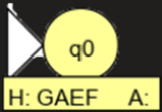
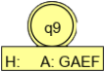
Thinking time
Whenever we change states, the golem crosses the portal with an entity or alone
So the Σ is {A,E,F,N}
The starting state is going to be q0, where the HOME side has the golem, Adam, Eve and the apple
The final state is going to be q9 where the AWAY side has the golem, Adam, Even and the apple
We will be constructing the solution on JFLAP 7.1 which can simulate finite automata
Helpful hint: pretend that you are the machine
Here is how to visualize the start and end states:

Slide 11
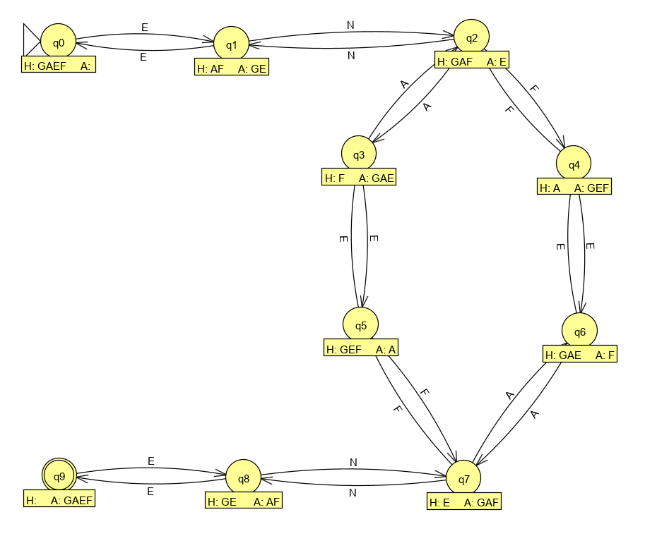
State Diagram: Built with JFLAP

Slide 12

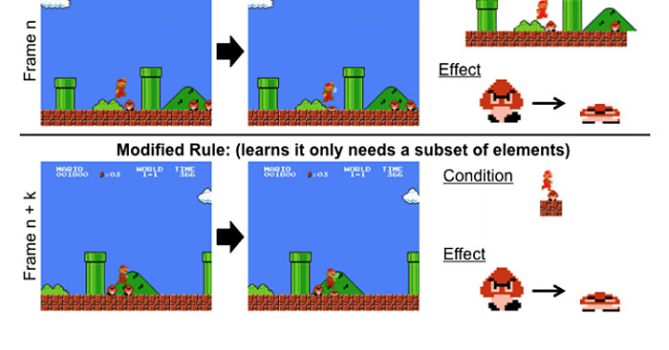

Gaming
There are a few places in gaming where a DFA can be used:
In enemy AI (an enemy spots the player then begins to throw gobs of sludge)
In main character progression
Your inventory can be built from a set of states
The missions/goals you completed can be simulated with a DFA
To restart to a checkpoint if a player dies (and the checkpoint you’ve currently reached)

Slide 13

Construct a DFA where the string starts and ends with a or starts and ends with b
Q = a set of states
Σ = {a,b}
Transition will be demonstrated with state diagram
q0 is the start state
There are multiple stop states in F

Slide 14
State Diagram
We’ll create it in the class notebook
It’s also available in page 38 if our text

Slide 15

Design a DFA where the number of 1’s is a positive even value Alphabet is {0,1}

Slide 16


Formal definition of computation
Let M = {$Q, Σ, δ, q0, F$} be a finite automaton
Let w = $w_{1}w_{2}…w_{n}$ be a string where each $w_{i}$ is an element of the alphabet $Σ$
Then M accepts w if a sequence of states $r_{1},r_{2},…,r_{n}$ in Q exist with 3 conditions:
$r_{0}= q_{0}$ M starts in the start state
$δ\left(r_{i},w_{i+1}\right)= r_{i+1}$ for i in 1…n-1 M follows $δ$ from state to state
$r_{n} ∈ F$ M accepts input w if it ends in an accept state
All 3 criteria make up finite automaton computation

Slide 17

Regular operations
Like the operations in real and rational numbers, there are operations in regular languages
The operations might be familiar from set theory
These operations are Union, Concatenation and Kleene Star (or just Star)
Union: $A ∪ B=\left\{x \right| x \text{∈} \text{A} \text{or} \text{x}\text{ ∈ }\text{B}\text{\}}$
Concatenation: $A ∘B=\left\{xy \right| x \text{∈} \text{A} \text{and} \text{y}\text{ ∈ }\text{B}\text{\}}$
Star: $A^{∗}=\left\{x_{1}x_{2}…x_{k} \right| k≥0 and each x_{i} \text{∈} \text{A}\text{\}}$
For these operations, we will prove the union operation together
Try to prove concatenation and star yourselves and then we will go over them next class

Slide 18
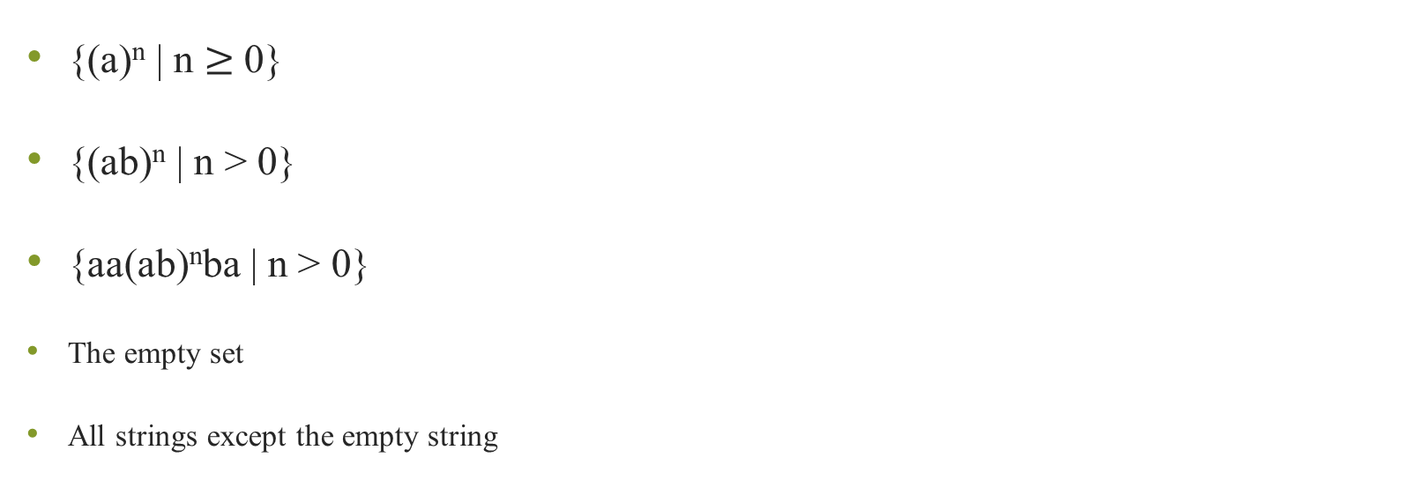
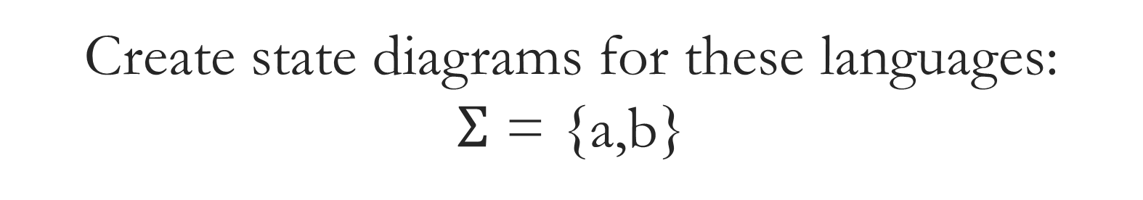
Create state diagrams for these languages: $Σ$ = {a,b}
{(a)^{n} | n $≥$ 0}
{(ab)^{n} | n > 0}
{aa(ab)^{n}ba | n > 0}
The empty set
All strings except the empty string

Slide 19
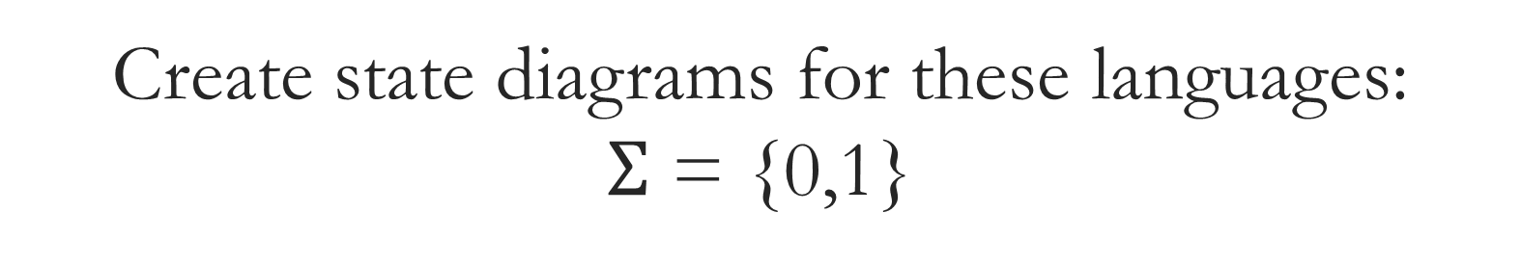
Create state diagrams for these languages: $Σ$ = {0,1}
{w | w begins with a 1 and ends with a 0}
{w | w contains at least four 1s
{w | w doesn’t contain the substring 110}
{w | w is any string except 11 and 111}
{w | w contains at least two 0s and at most one 1}

Slide 20
Regular language facts:
Can regular languages be finite?
Yes
Must regular languages be finite?
No
Finite languages are solvable in linear time

Slide 21
Create state diagrams for these languages: $Σ$ = {a,b}
{a^{n}b^{n} | n > 0}
{a^{m}b^{n} | m,n > 0}

Slide 22

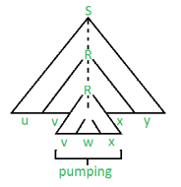
The pumping lemma
The reason why you can’t construct state diagrams for the above languages is because those languages aren’t regular
Recall that if a finite automata can recognize a language, then the language is regular
However, not all languages are regular
DFAs (and by extension regular languages) don’t operate on a lot of memory and the above problems needs memory
So how do we prove this? Using the pumping lemma…

Slide 23
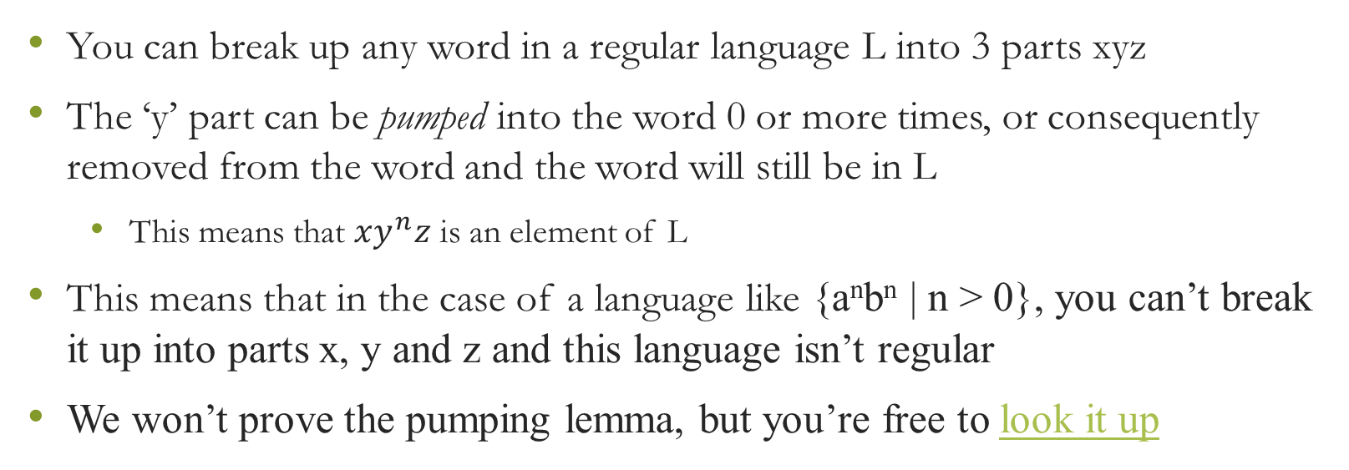
What does the pumping lemma say?
You can break up any word in a regular language L into 3 parts xyz
The ‘y’ part can be pumped into the word 0 or more times, or consequently removed from the word and the word will still be in L
This means that $xy^{n}z$ is an element of L
This means that in the case of a language like {a^{n}b^{n} | n > 0}, you can’t break it up into parts x, y and z and this language isn’t regular
We won’t prove the pumping lemma, but you’re free to look it up

